Slide 1
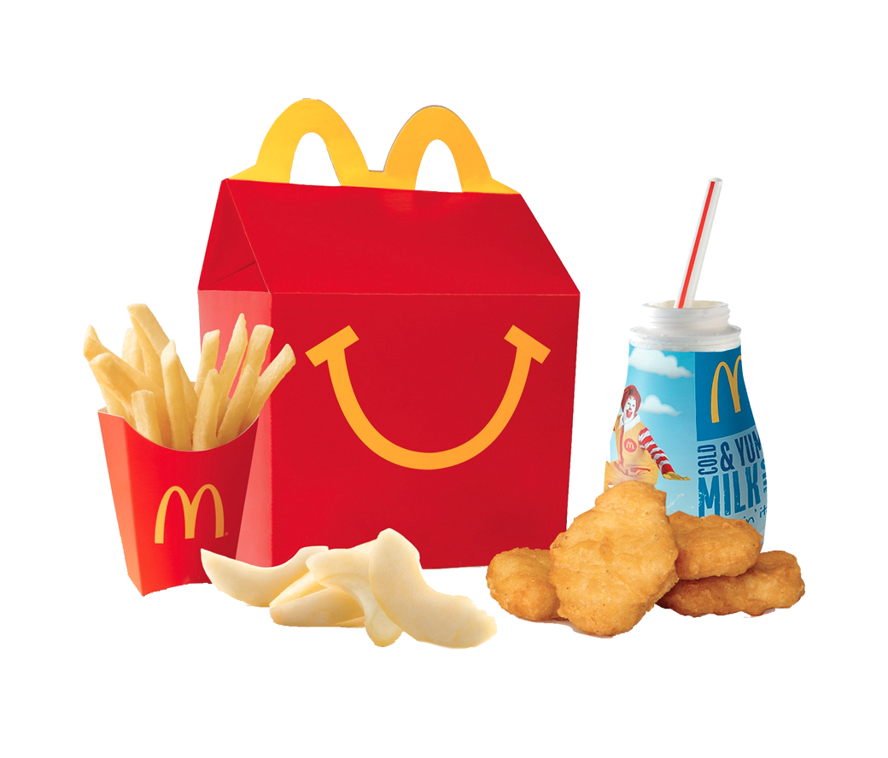
Coding the Happy Meal

Slide 2

A little about me

Slide 3
A little bit about procedural code
Query database for list of program members
Loop through members
Check if member’s settings allow for emails to be sent
If user is a man and emails are allowed
Query database and get email message for men
If user is a woman and emails are allowed
Query database and get email message for women
Get member’s name and, if there is a preferred name, use it otherwise use first name
Construct email
Connect to SMTP server and send email
Add member’s email address to a list of Recipients
Query the database to update member’s record that email was sent to them
Query the database of all related program managers
Loop through them
Send them an email with a list of all recipients
…

Slide 4
A little bit about procedural code
Task based
Sequential
Many decision trees
If/Else statements
Repetitive
In the bigger picture, VERY repetitive.
Querying the database for the same information in multiple places
Making the same decisions in multiple places. Like using preferred name instead of first.
Due to the specificity of the tasks being accomplished, the more complex the system becomes, the more difficult to change it.

Slide 5
How is OOP different?
Model the world you are interacting with
Member
Manager
Email
Settings
Email Service
Build behavior into your objects outside of a specific set of tasks:
member.preferred_name #return preferred,first if not available
member.get_message #return gender specific message email.send(message) #sends email via SMTP server

Slide 6
What is an Object
Super simple explanation
An object is a data construct that has attributes and behaviors.
Attributes are also known as properties. A car might be an object, it may have attributes of color (green) and top speed (125)
Behaviors are known as methods or functions. An object may have many methods. A car may have methods “stop” and “go”

Slide 7
Ruby Object
class Soda < Drink
def initialize(syrup, water)
@syrup = syrup
@water = water
@calories = 100
end
def calories
return @calories
end
end

Slide 8
Object Domain
You are presented with a set of features or functions your web app needs to have.
What are the real world objects that are involved?
What are their properties?
What are their behaviors?
How do they relate to each other?
A good Object Domain will
allow you to ask it questions and get back answers
allow you to extend it, building in new features
allow you to fix broken parts without affecting the overall system

Slide 9
Four Core Principles

Slide 10
Four Core Principles
Encapsulation

Slide 11
Four Core Principles
Encapsulation
Inheritance

Slide 12
Four Core Principles
Encapsulation
Inheritance
Composition

Slide 13
Four Core Principles
Encapsulation
Inheritance
Composition
Polymorphism

Slide 14
Encapsulation
All data associated with an object is “private”
Properties/Attributes are private
Methods to access properties are public
Methods can also be private
You have to “ask” the object to get or change a property
Core methods are called:
Accessors
Getters and Setters
Mutators

Slide 15
Inheritance
Objects can inherit properties and behaviors from other objects
Sub Classes
Super Classes
Sub classes “inherit” properties and behaviors from its super class
Sub classes “overwrite” properties and methods that are specific to it

Slide 16
Inheritance
Super Class: Car
Property: Top speed
Method: go(‘fast’)
Sub Class 1 : Clunker
“Type” of Car
Top Speed property is set to 25
It inherits a “go” method, but can only go 25mph
Sub Class 2: Sports Car
“Type” of Car
Top Speed property is set to 125
It inherits a “go” method, but it can go 125mph

Slide 17
Inheritance
“Is A”
A clunker “is a” car
A dolphin “is a” mammal
A mammal “is an” animal
A dolphin “is a” animal
A Sprite “is a” drink

Slide 18
Composition
Single Objects are composed of multiple other objects
Is generally preferred over inheritance
Allows for greater flexibility as systems become more complex
Does not prevent inheritance and can extend a super classes
Often, the nature of a composed object is determined more by the objects it is composed of rather than it’s own properties or attributes

Slide 19
Composition
“Has a”
A car “has a” engine
A car “has” 4 wheels
A human “has” opposable thumbs
A happy meal “has a” drink
A happy meal “has a” hamburger
A happy meal “has a” small fries

Slide 20
Composition vs. Inheritance
Inheritance Example
Object: Car
Sports Car is a car
Clunker is a car
Sports Car/Clunker “extends” the car super class
The sub classes overwrite the top speed property

Slide 21
Composition vs. Inheritance
Composition Example
Object: Car
Has a transmission
Has four wheels
Has an engine
Engine object has a top speed property
Unlike inheritance, top speed is not determined by the car’s top speed attribute but by the type of engine it is composed with.

Slide 22
Polymorphism
Two or more objects of different classes respond to the same method
Example: The Cut() Method
Doctors Cut
Hair Stylists Cut
Directors Cut
Serial Killers Cut
In each case, the object “cuts”, but the action is different

Slide 23
The Happy Meal
Notes:
The happy meal;

Slide 24
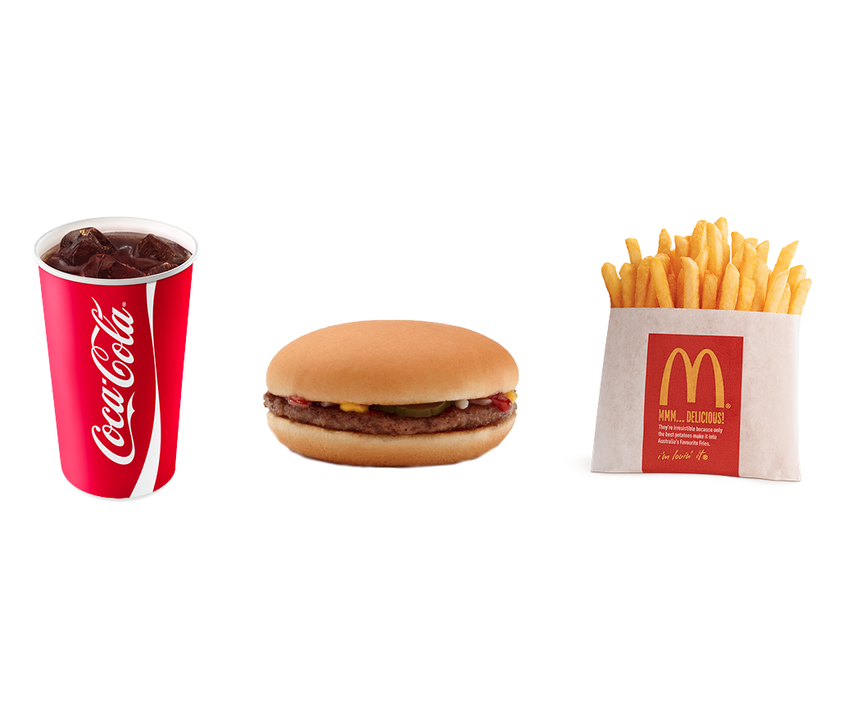
Three Simple Items
Notes:
The basic elements of a meal => drink, main course and a side

Slide 25
Three Simple Items
Is it really that simple?
Notes:
The basic elements of a meal => drink, main course and a side

Slide 26
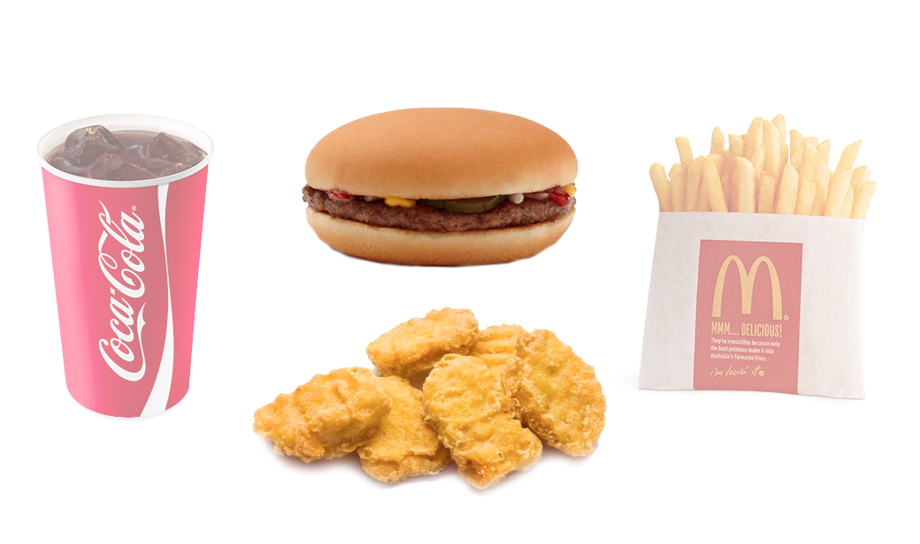
Three Simple Items
Notes:
Now you have to take into consideration two different main courses

Slide 27
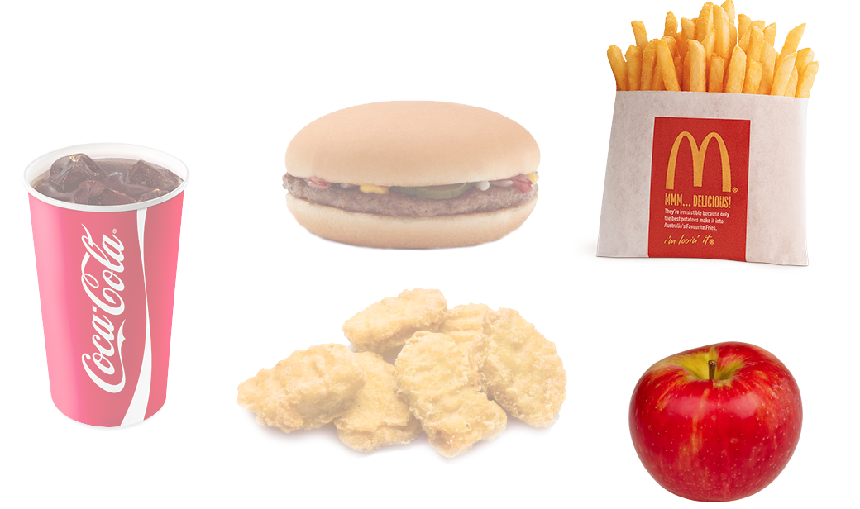
Three Simple Items
Notes:
Now two different sides?

Slide 28
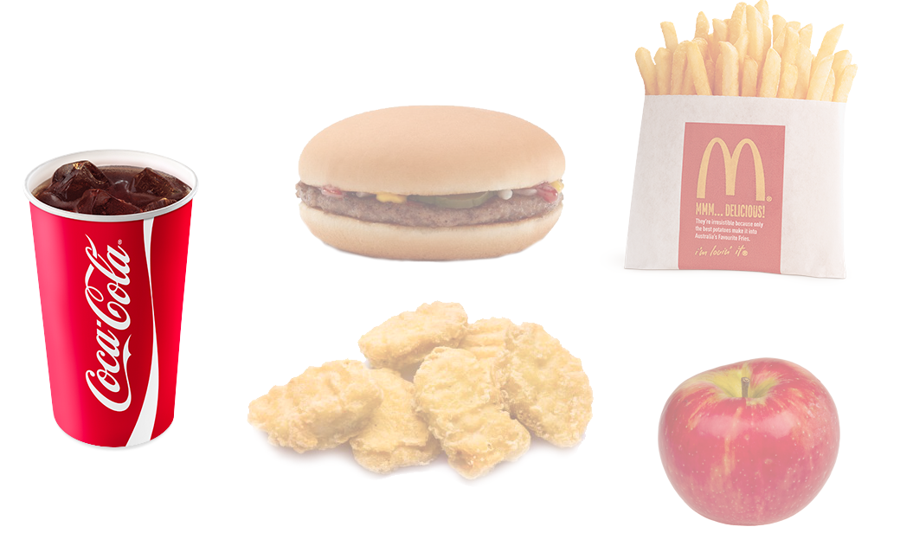
Three Simple Items
Notes:
Let’s consider the drink

Slide 29
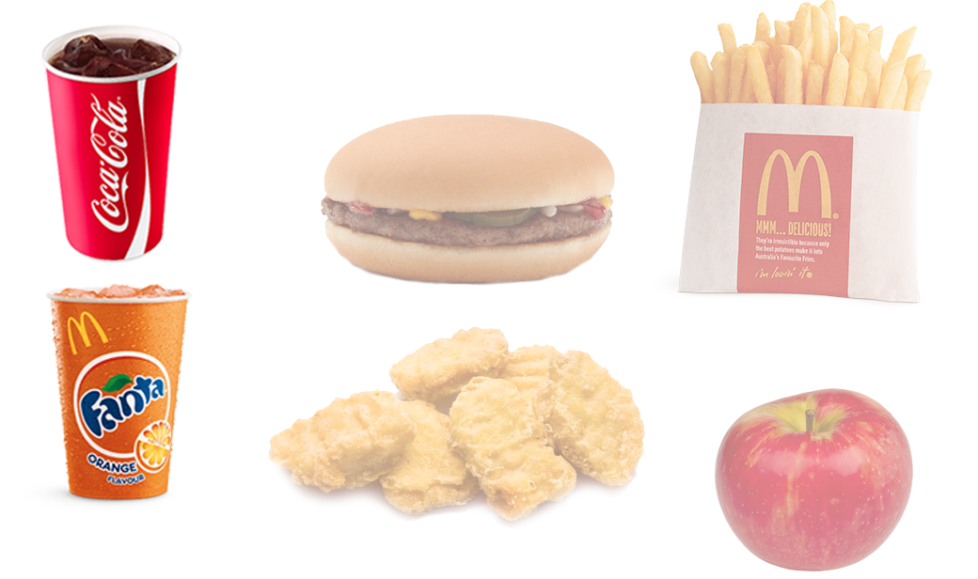
Three Simple Items
Notes:
What about other types of pop like fanta or sprite?

Slide 30
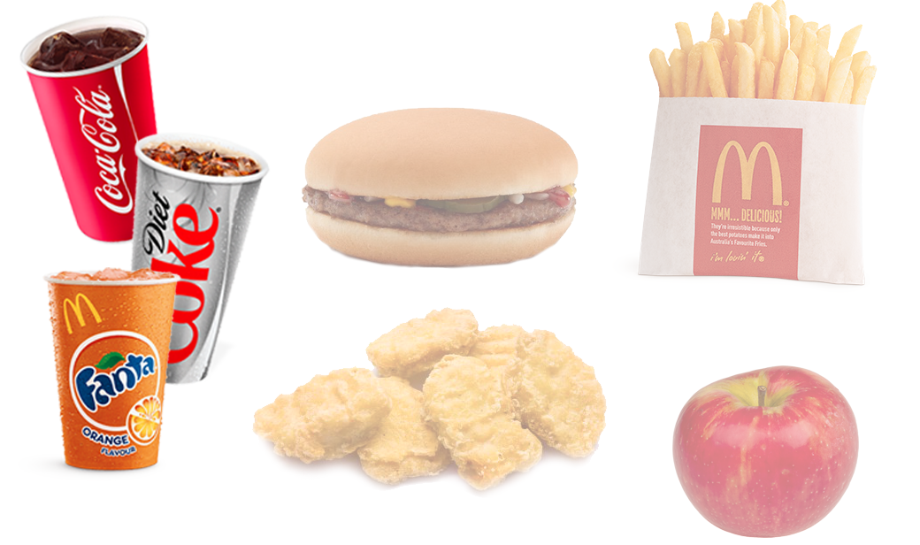
Three Simple Items
Notes:
Diet is also pretty different

Slide 31
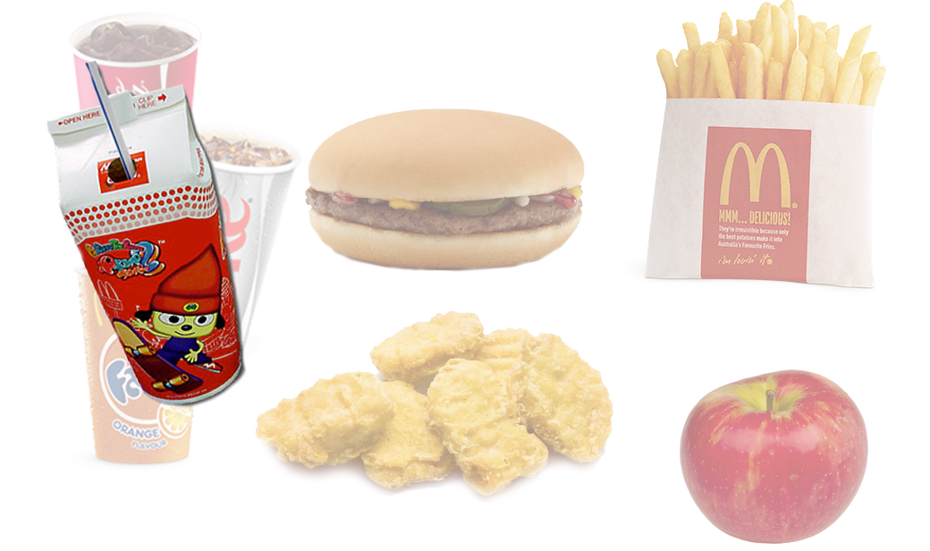
Three Simple Items
Notes:
Diet is also pretty different

Slide 32
Composition
/ (╯°□°）╯︵ ┻━┻
Not so simple after all…
Notes:
The happy meal;

Slide 33
Composition
Composition allows for flexibility. The variety of different combinations of a “Happy Meal” object can be left to the objects that actually compose the meal.
Outside of the variety, a happy meal IS actually pretty simple!
A Happy Meal has a drink
A Happy Meal has a main course
A Happy Meal has a side dish

Slide 34
Composition
Composition allows for flexibility. The variety of different combinations of a “Happy Meal” object can be left to the objects that actually compose the meal.
Outside of the variety, a happy meal IS actually pretty simple!
A Happy Meal has a drink
A Happy Meal has a main course
A Happy Meal has a side dish
A Happy Meal has a toy

Slide 35
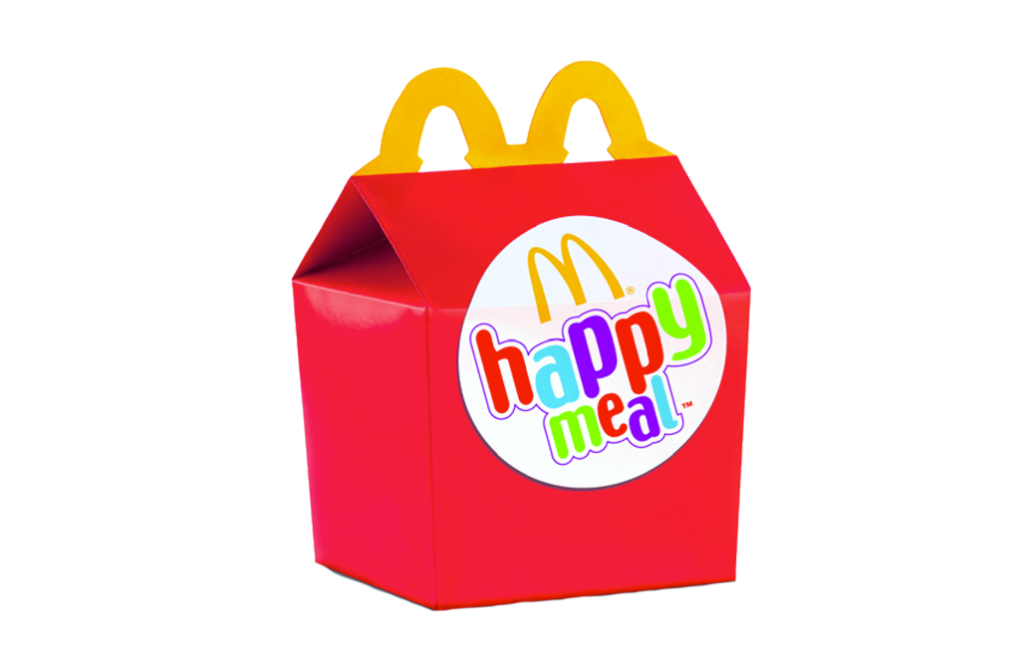
Encapsulation
How many calories are in this happy meal?

Slide 36
Three Simple Items
Let’s break this down into an Object Domain using all 4
principles of object oriented programming…
Notes:
The basic elements of a meal => drink, main course and a side

Slide 37

Inheritance: The Soft Drink

Slide 38
Inheritance: The Soft Drink
If many possible objects share the same characteristic or properties, then inheritance will allow you to consolidate all the shared characteristics in a “Super Class”.
A generic soft drink has several possible properties:
Carbonated Water
Syrup
Ice
Syrup to carbonated water ratio
Syrup is what differentiates all soft drinks.

Slide 39

The Soft Drink: Coke
A Coke inherits from “Soft Drink” and overwrites syrup property with “coke”

Slide 40
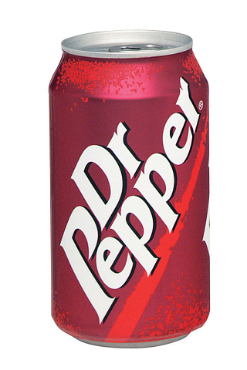
The Soft Drink: Coke
A Dr. Pepper inherits from “Soft Drink” and overwrites syrup property with “dr. pepper”

Slide 41

The Soft Drink: Coke
A Sprite Zero inherits from “Soft Drink” and overwrites syrup property with “sprite zero”

Slide 42
Inheritance: The Soft Drink
With all three of these soft drinks. The only difference is the syrup used.

Slide 43
Inheritance: Profit
McDonald’s want to maximize profits by saving on syrup used in their soda fountains. It would be pretty tedious to go and alter every single different type of soda…

Slide 44
Inheritance: Profit
Remember these 4 properties?
Carbonated Water
Syrup
Ice
Syrup to carbonated water ratio

Slide 45
Inheritance: Profit
Remember these 4 properties?
Carbonated Water
Syrup
Ice
Syrup to carbonated water ratio

Slide 46
Inheritance: Profit
Remember these 4 properties?
Carbonated Water
Syrup
Ice
Syrup to carbonated water ratio
Update all syrup to water ratios for ALL soft drinks by updating the super class!

Slide 47
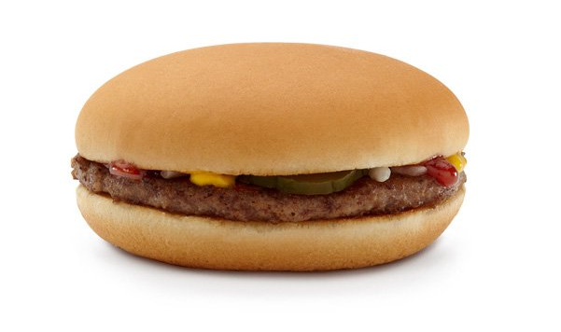
The Hamburger

Slide 48
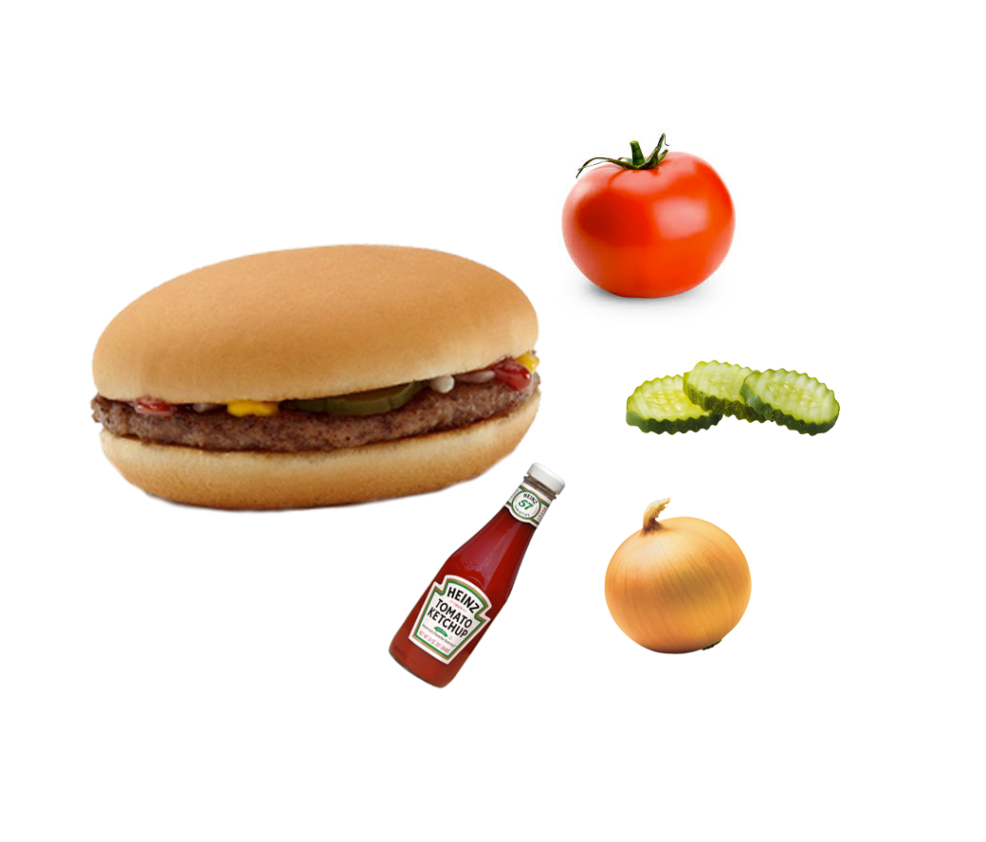
The Hamburger

Slide 49
The Hamburger
A hamburger is composed of:
Meat
Bun / Bread
A variety of condiments
Could have no condiments
Could have a ton of condiments

Slide 50
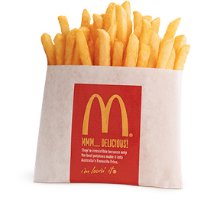

Side Dishes?
At this point. Fries are just fries. And apples are just apples. Just two different objects that neither inherit from another object or are composed of multiple objects.

Slide 51
The Happy Meal
This little happy meal has become pretty complex!!!
Happy meal is composed of:
1 Drink that inherits from “Soft Drink”. The drink will swap out the syrup to make it the correct type
1 Main meal that could be chicken nuggets OR a hamburger. If a hamburger, then the main meal is actually an object that is composed of several other objects. We don’t actually know how many.
1 Side Dish that is just a plain object. No inheritance or composition. Just a boring object.

Slide 52
The Happy Meal
But how many calories are in this happy meal?

Slide 53
Encapsulation!
Wouldn’t it be nice if we could just ask the happy meal how many calories it is?
Sounds like a difficult question to answer!
Wouldn’t it be nice if we could ask a soft drink how many calories it is?
Well that sounds easier. It’s just the syrup.
Wouldn’t it be nice to ask a hamburger how many calories it is and have the answer be immediately adjusted based on the number and types of condiments that were added?
Good grief…

Slide 54
Encapsulation: Soft Drinks
A Soft Drink object can respond to a method asking how many calories it has. The object will look up it’s “diet” Boolean flag (true or false) and return either 140 or 0, if diet.
Nothing but the Soft Drink object needs to know how this is determined.
At a later date, a more exact calculation based on syrup and “syrup to water” ratios can be implemented.
Any sub type of Soft Drink (sprite, coke, fanta) can respond to this method because it has been inherited.

Slide 55
Encapsulation: Side Dishes
Both Fries and Apples are independent objects that simple have a calories property and a Getter method implemented. In both of these cases, the number of calories is a static value that is returned

Slide 56
Encapsulation: The Hamburger

Slide 57
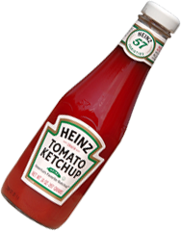
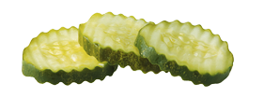
Encapsulation: Condiments
Condiments has become a new object used in constructing a happy meal.
Condiments are very simple objects that can also respond to a calories method.

Slide 58
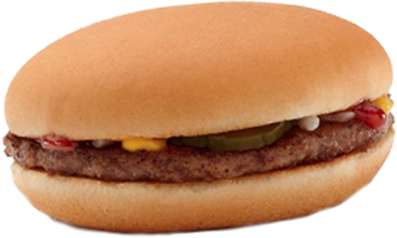
Encapsulation: Hamburger
Hamburger also responds to calories. It determines total calories by calculating 150 for the bun and 200 for the all beef patty. Then, on top of the 350 calories, it will ask each and every condiment how many calories it is and then add the responding numbers

Slide 59
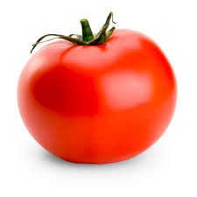
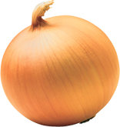
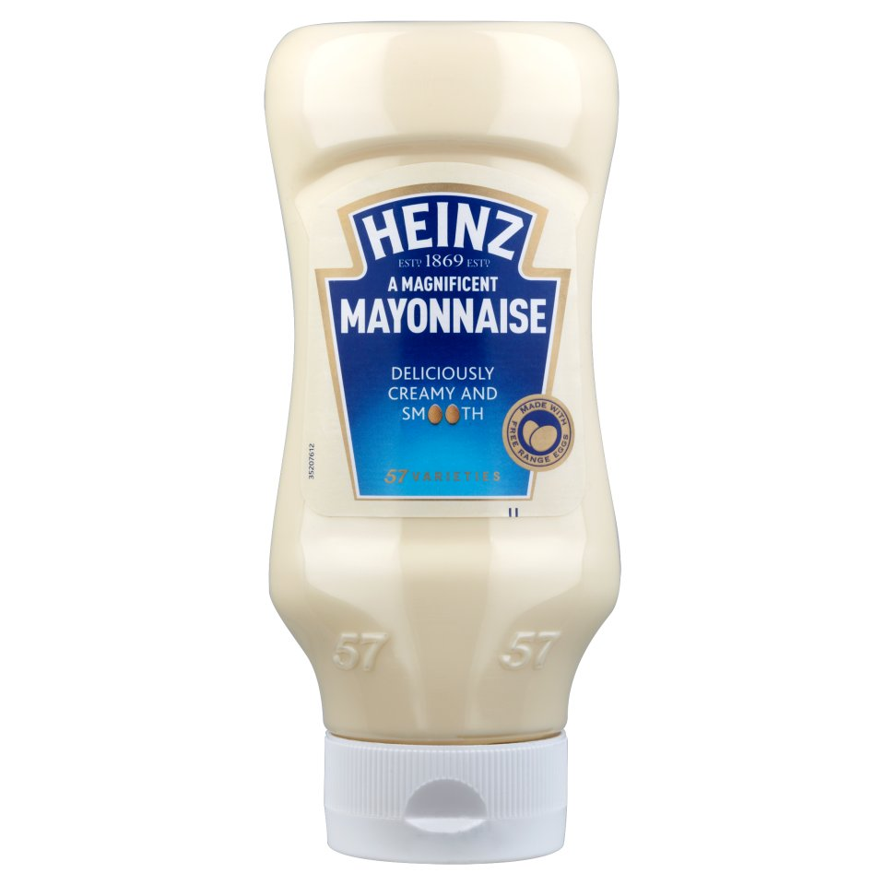
Encapsulation: Hamburger
+ 15 calories
+ 10 calories
350 Calories
+ 5 calories
+ 30 Calories
410 Total Calories

Slide 60
Encapsulation: Hamburger
The hamburger responds to a simple calories method. No other object knows how it is determining the number.
The hamburger, likewise, is asking each condiment how many calories.
It has no idea how the condiments are determining their number.

Slide 61
The Happy Meal
But how many calories are in this happy meal?

Slide 62
The Happy Meal
But how many calories are in this happy meal?
Ask the happy meal. It will tell you. You will
have no idea how the number is determined
But the Happy Meal…
Asks the drink how many calories
Asks the side dish how many calories
Asks the main meal how many calories
Add them together

Slide 63
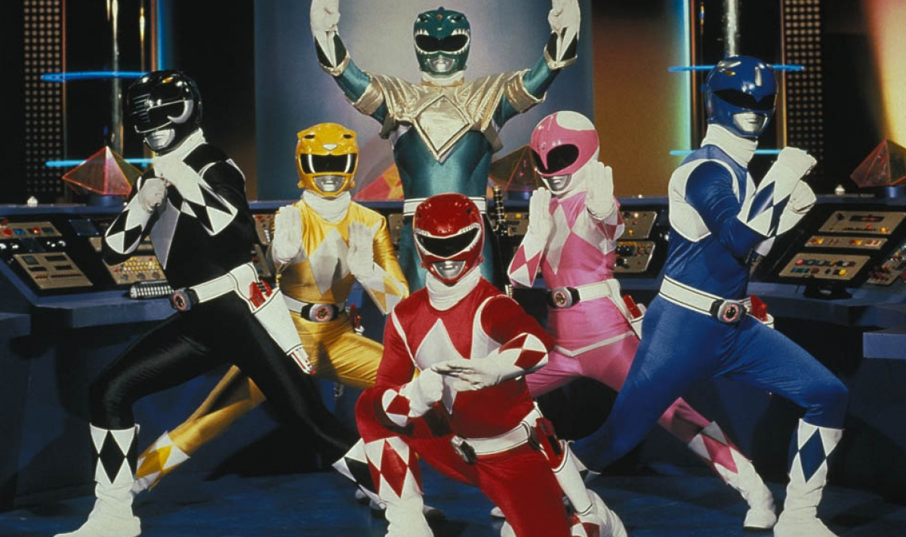
What about Polymorphism?

Slide 64
What about Polymorphism?
We have been asking a lot of different types of objects how many calories they have…
In code:
condiment.calories
sprite.calories
fries.calories
hamburger.calories
happy_meal.calories

Slide 65
What about Polymorphism?

Slide 66
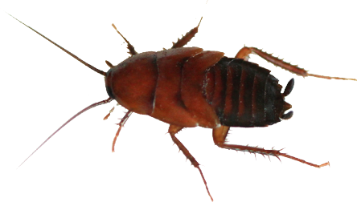
What about Polymorphism?

Slide 67
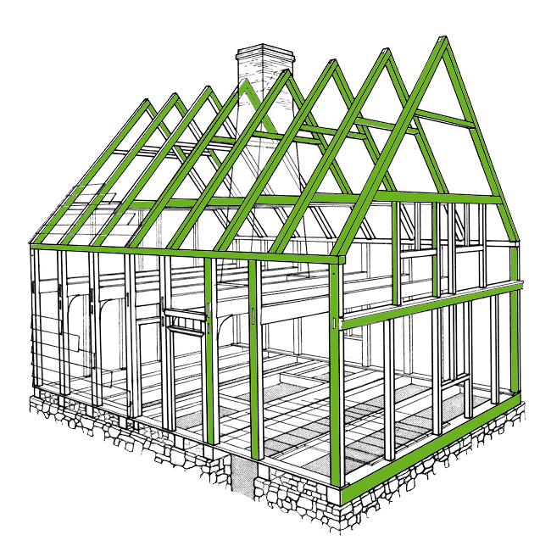
Frameworks

Slide 68
What is MVC?
Model View Controller
Design pattern / Architecture
Standard in the design of modern web applications
Decouple Presentation from Data
Separation of Concerns

Slide 69
What is a Framework
…is an abstraction in which software providing generic functionality can be selectively changed by user code, thus providing application specific software. It is a collection of software libraries providing a defined application programming interface (API).
From wikipedia.org

Slide 70
What is a Framework
Allows designers and programmers to devote their time to meeting software requirements rather than dealing with the more standard low-level details of providing a working system, thereby reducing overall development time
From wikipedia.org

Slide 71
Why?
Structured and consistent
Alleviates common tasks
Makes things easy
Makes you productive
Makes teamwork easier
Makes applications easier to support
Makes applications easier to extend

Slide 72
What is MVC?
Model

Slide 73
What is MVC?
Model
Your Data
Business Logic
Knows nothing about how the data will be presented to a user

Slide 74
What is MVC?
Model
View

Slide 75
What is MVC?
Model
View
Presentation Layer
HTML/CSS
XML/JSON
PDF
Has no idea where the data came from

Slide 76
What is MVC?
Model
View
Controller

Slide 77
What is MVC?
Model
View
Controller
Receives request from user
Talks to the model to get any needed data
Passes data to the view

Slide 78
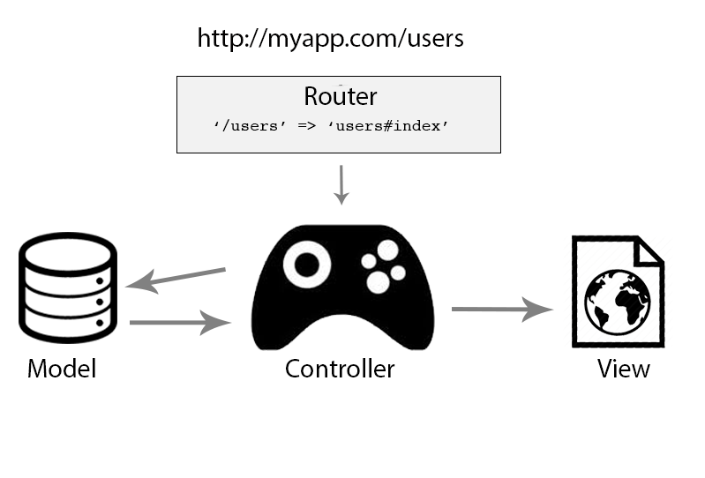
What is MVC?
http://myapp.com/users

Slide 79
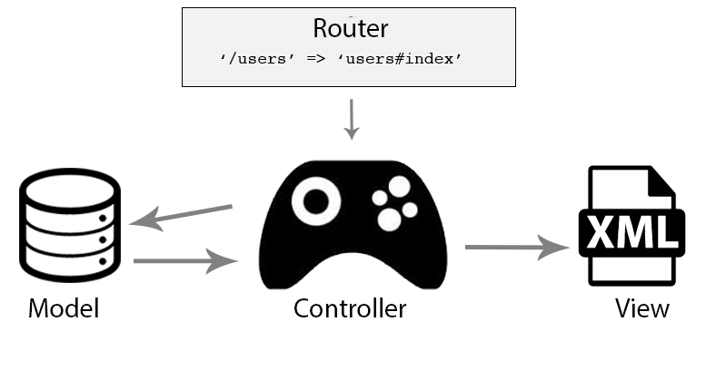
What is MVC?
http://myapp.com/users.xml

Slide 80
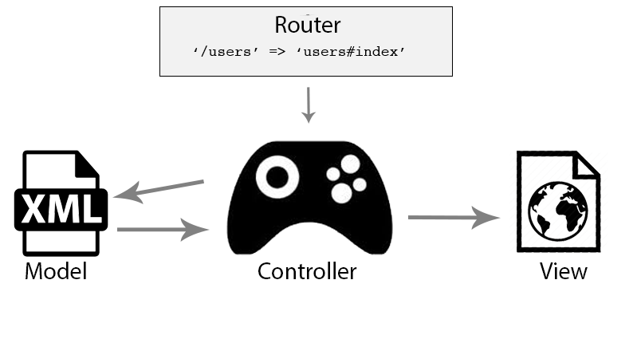
What is MVC?
http://myapp.com/users

Slide 81
Happy Meals
Happy Meals themselves
Objects
Composed of other Objects
Composed of other Objects using Inheritance
Composed of other Objects composed of other Objects

Slide 82
Happy Meals
Happy Meals themselves
Objects
Composed of other Objects
Composed of other Objects using Inheritance
Composed of other Objects composed of other Objects
What about ordering a Happy Meal?

Slide 83
Ordering a Happy Meal
Question:
How inefficient would it be if every person who worked at McDonalds took care of a single customer, one at a time?
Greet customer
Take order
Go in the back and cook food
Package food up
Take food to customer
Take money
Greet next customer

Slide 84
Ordering a Happy Meal
Question:
How inefficient would it be if every person who worked at McDonalds took care of a single customer, one at a time?
Instead, there are cashiers and cooks. There are managers.
They all have their specific role.
Cashiers do not need to learn to cook. Cooks do not need to learn to smile.

Slide 85
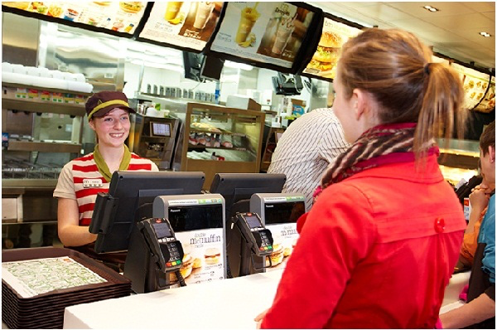
Controllers

Slide 86
Controllers
“Hi. I would like to order a happy meal.
Can I have it with a sprite, a hamburger
With ONLY pickles and ketchup.
And fries.”

Slide 87
Controllers
You do not care about who cooks your
food.
You do not care (or try to avoid thinking
about) how the food gets cooked.
You don’t talk to the cook. Your interaction
is with the cashier.

Slide 88
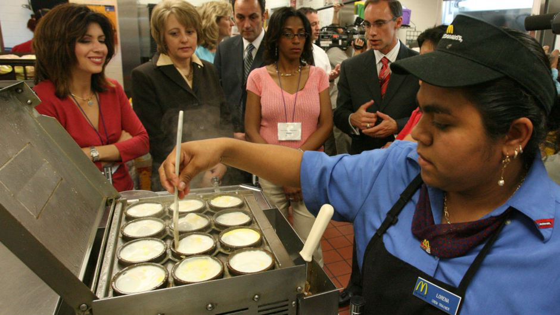
Models

Slide 89
Models
What are these people doing?

Slide 90
Models
The cook does not care
about you.
The cook doesn’t even know
you exist.
The cook talks to the
cashier. And the cashier
tells the cook what to
make.
Cooks do not have to smile.

Slide 91
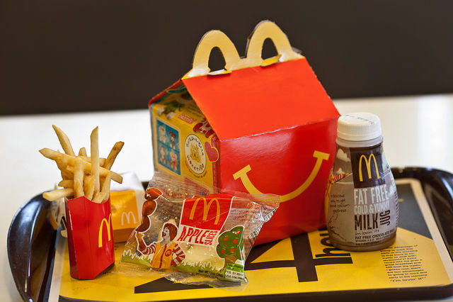
Views
This is what your order looks like

Slide 92
Views
And let’s be honest.
You don’t care about the
cashier or the cook, do you?
All you care about is that your food gets to you and that it is super delicious.

Slide 93
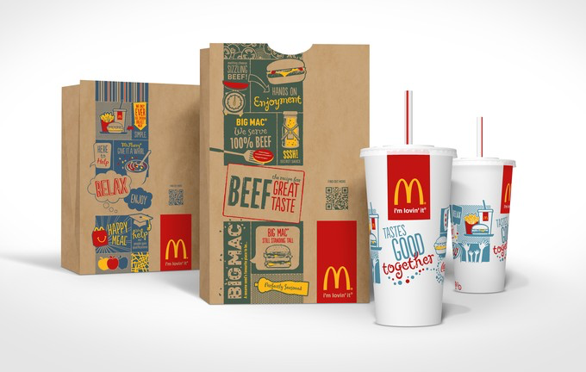
Views
What about orders “To Go”?

Slide 94
Views
“To Go” orders only affect
how the meal is packaged.
The ordering process is
exactly the same. The
communication between
the cashier and the cook
is exactly the same.
The cook still prepares the
food the same way.
The cook still doesn’t care about you. You are still avoiding thinking about
how your food has been made.

Slide 95
What is MVC?
http://myapp.com/users

Slide 96
API Access to your Web App
Your boss has a great idea. You need to build a web services layer. She wants you to allow API access to your app for third parties to integrate.
This is going to be great! But is it going to be major work? Are we going to have to rebuild our entire system?

Slide 97
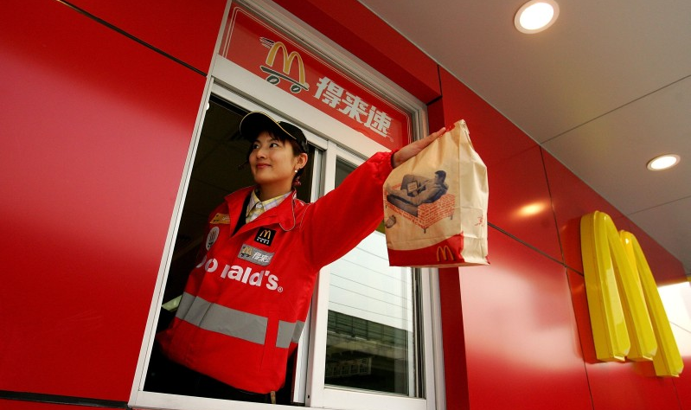
API Access to your Web App

Slide 98
Questions?

